Slide 1
TDD Lab
By AltoTech

Slide 2
Simple Unit Test with Python
PyCharm
Create is_prime(num)
Prime?
Num % Num == 0, Num % 1 ==0

Slide 3
TDD
Create Test first
Then, Create Function

Slide 4
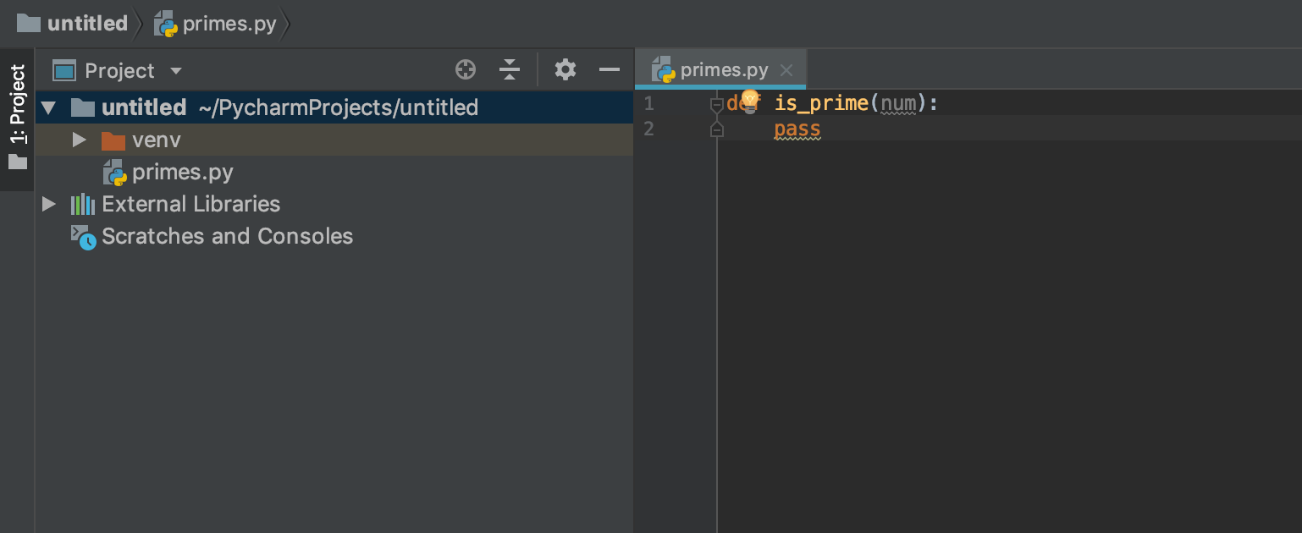
Create is_prime

Slide 5
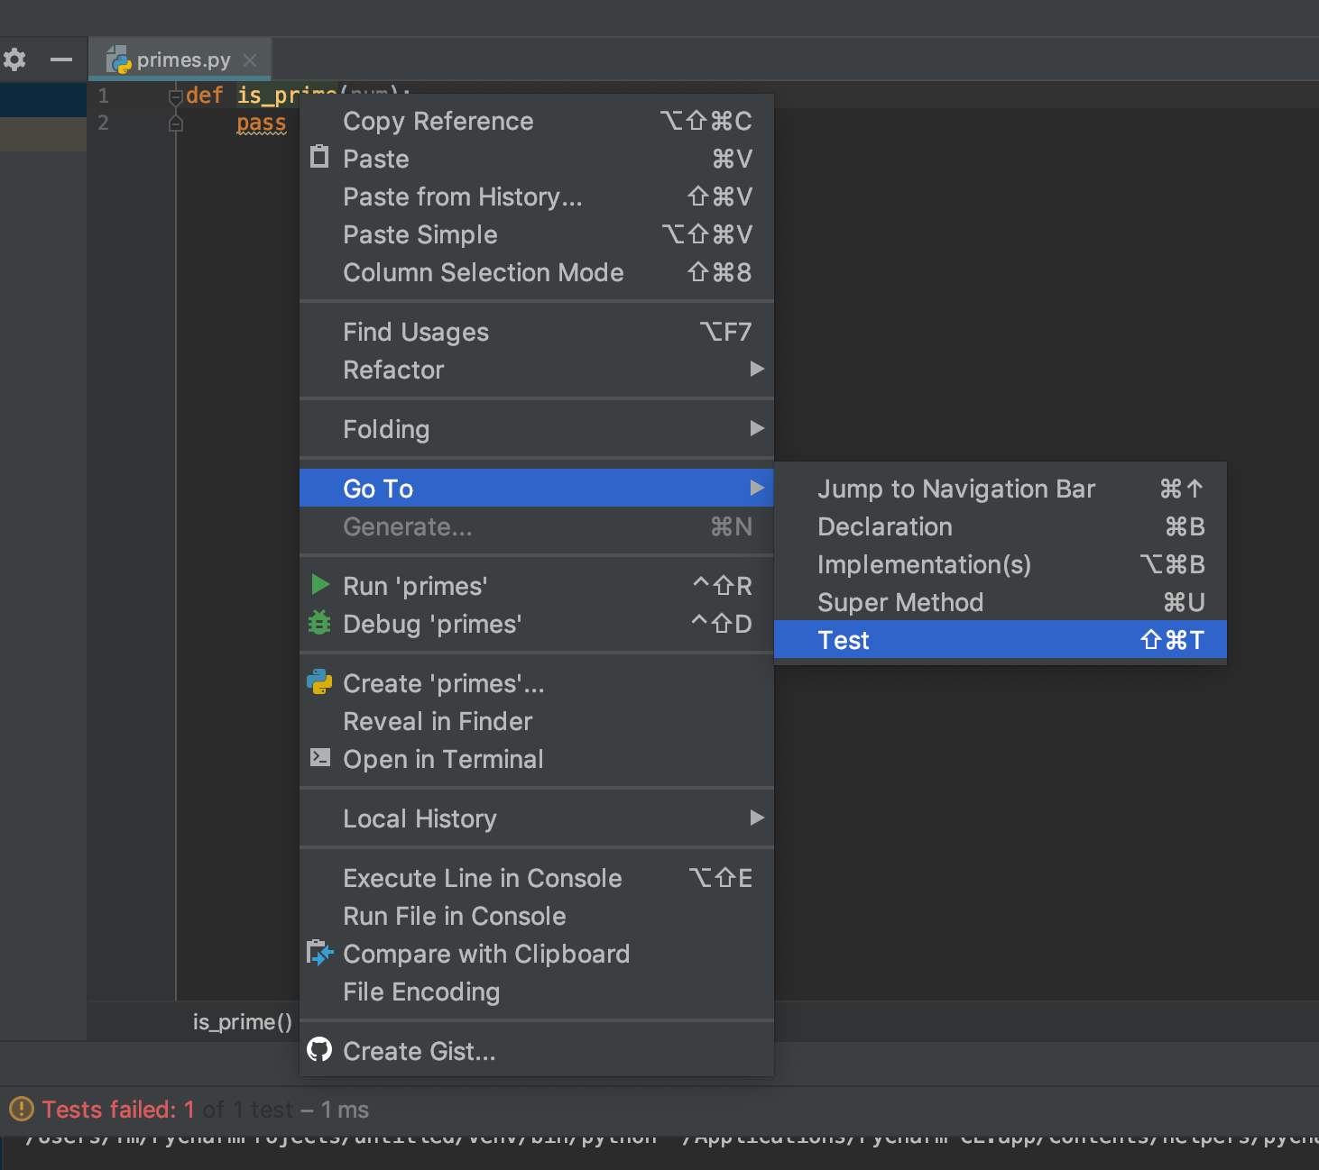
Create test_is_prime

Slide 6
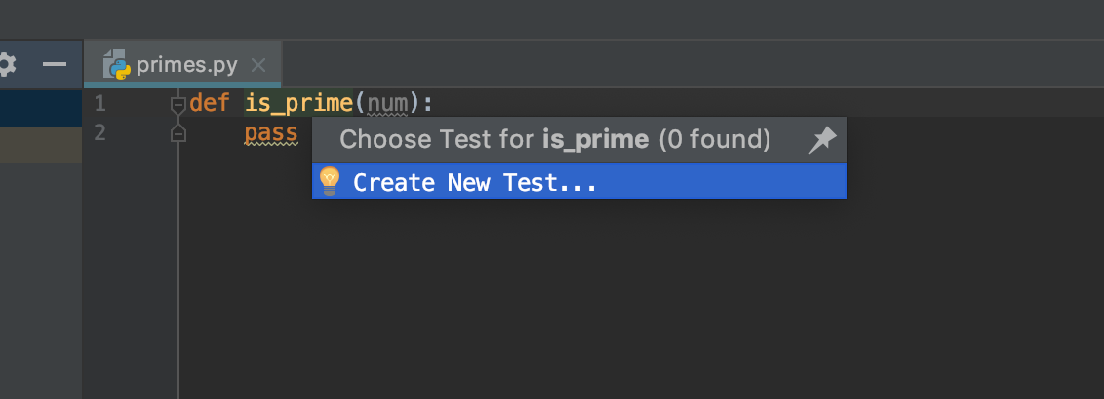
Create test_is_prime

Slide 7
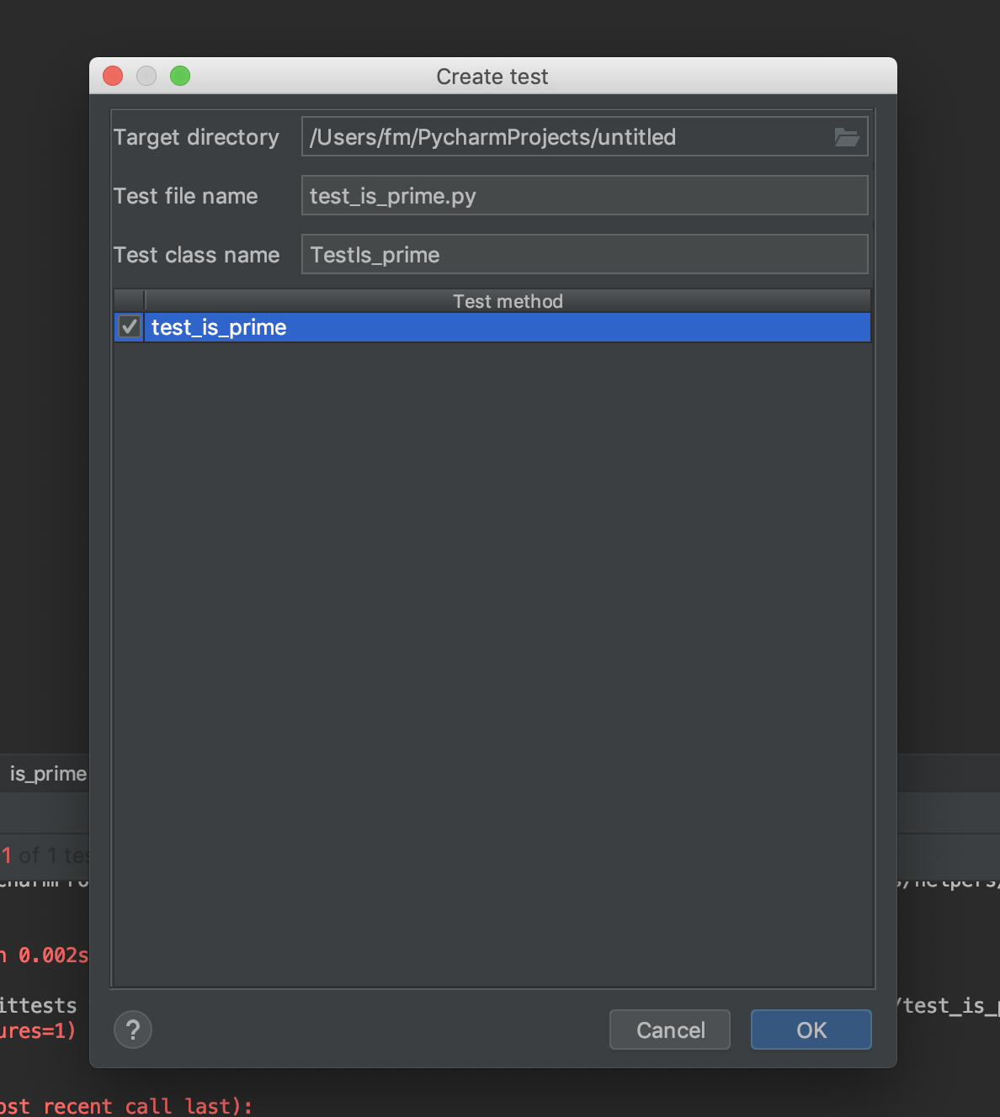
Create test_is_prime

Slide 8
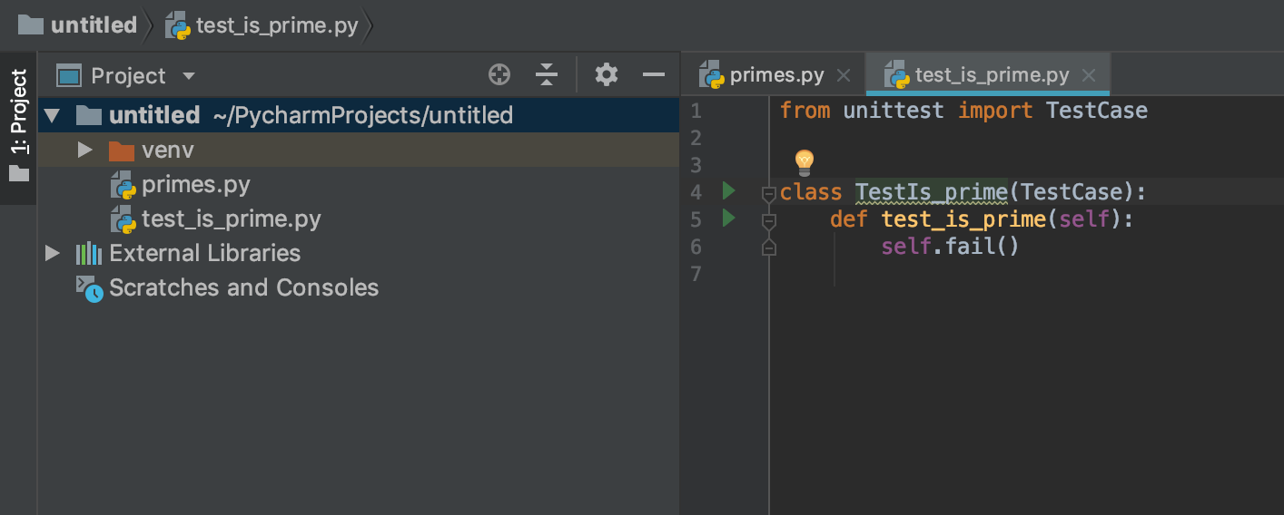
Create test_is_prime

Slide 9
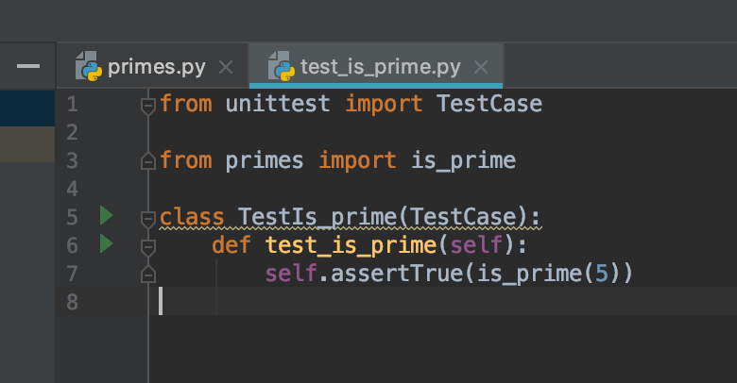
Create test_is_prime

Slide 10
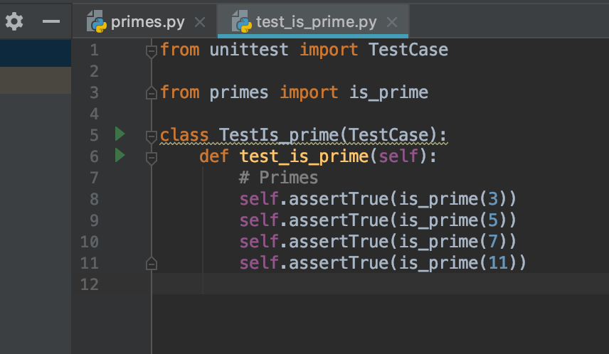
Primes
Primes: 3, 5, 7, 11

Slide 11
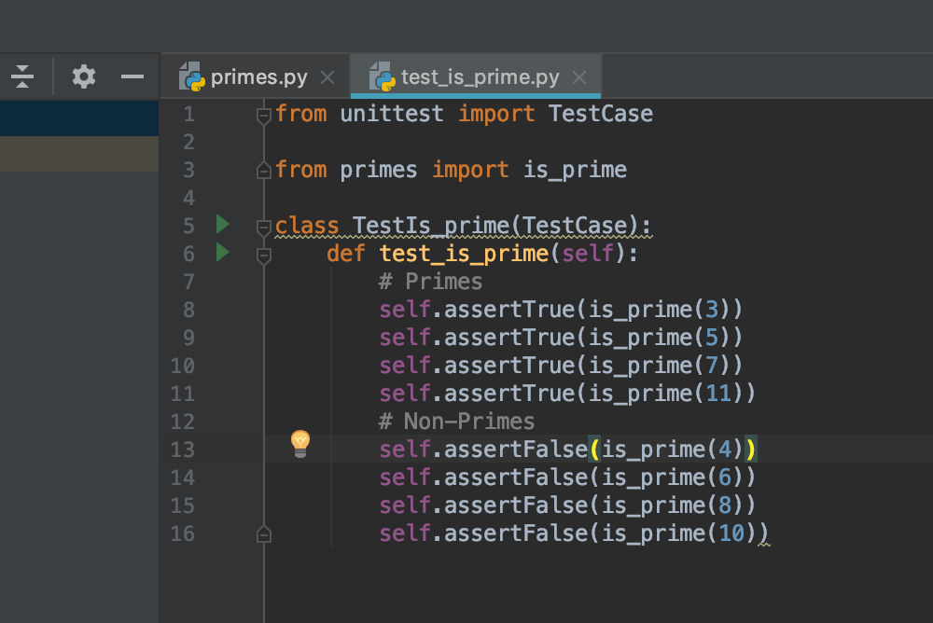
Non-Primes
Non-Primes: 4, 6, 8, 10

Slide 12
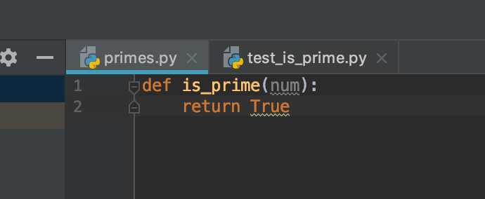
Fill is_prime

Slide 13
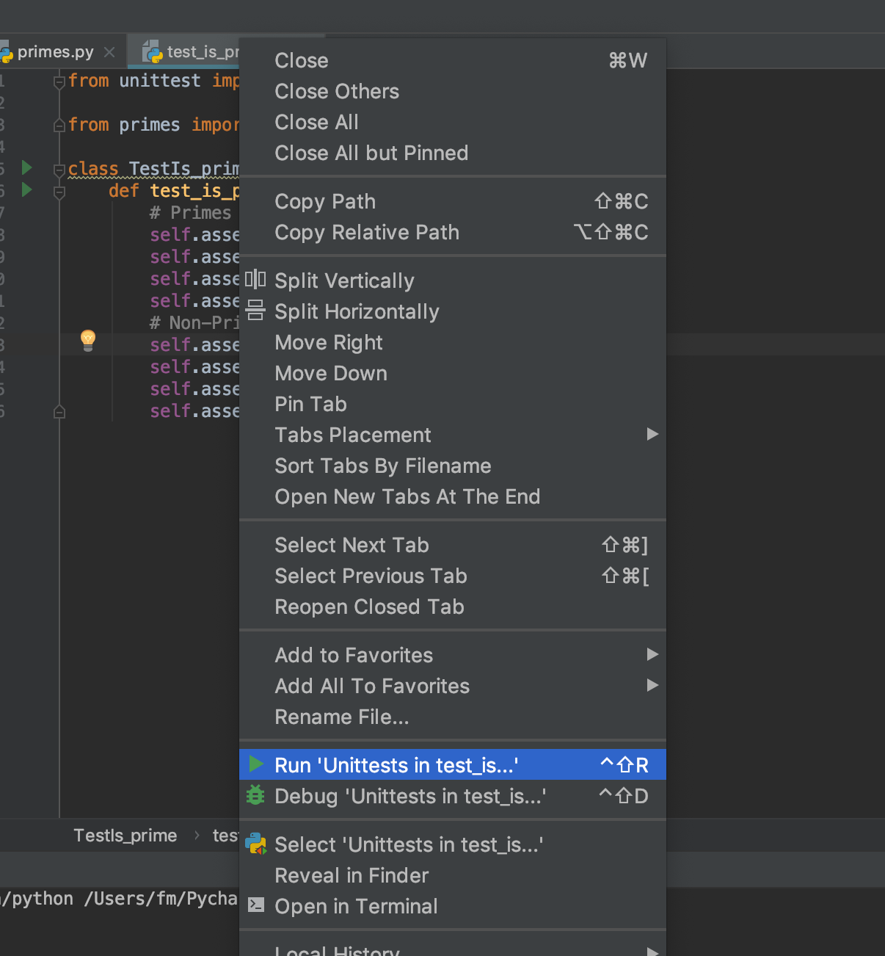
Run Test

Slide 14
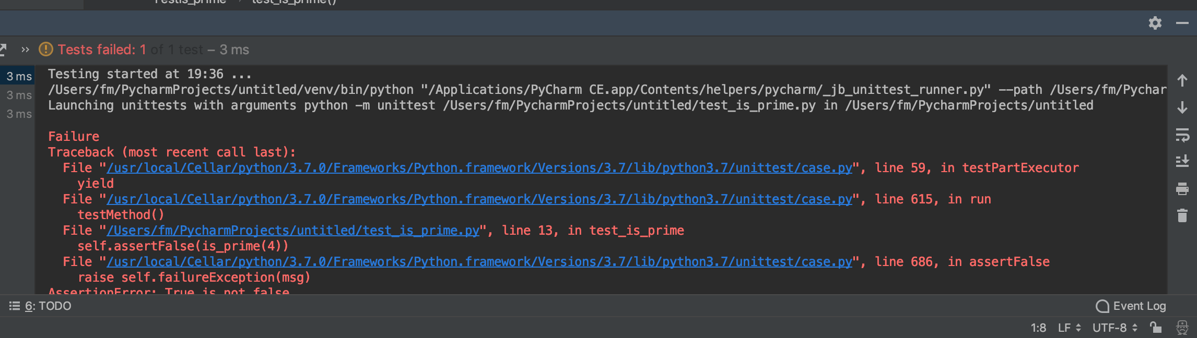
Run Test

Slide 15
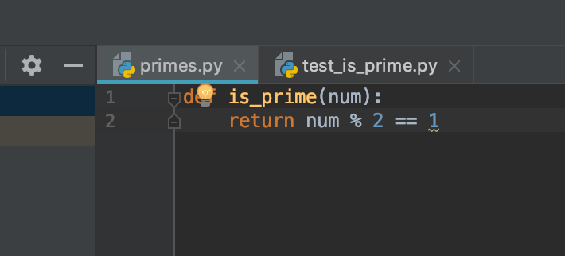
Fix is_prime

Slide 16
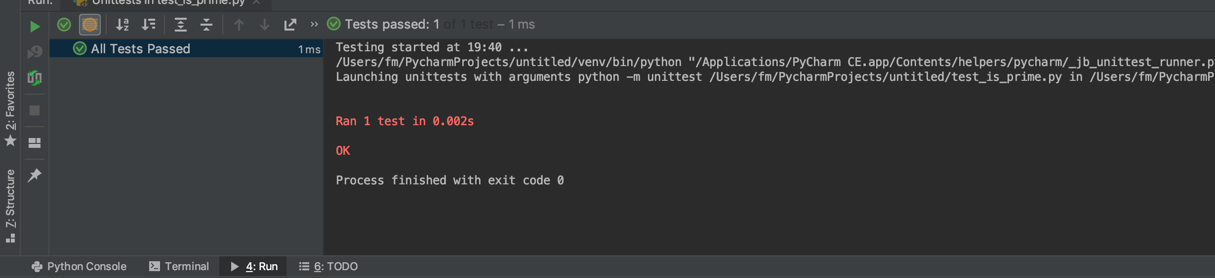
Run test again
All tests passed

Slide 17
Try adding test
Copy the code from
primes.py
test_is_prime.py
In Line Group

Slide 18
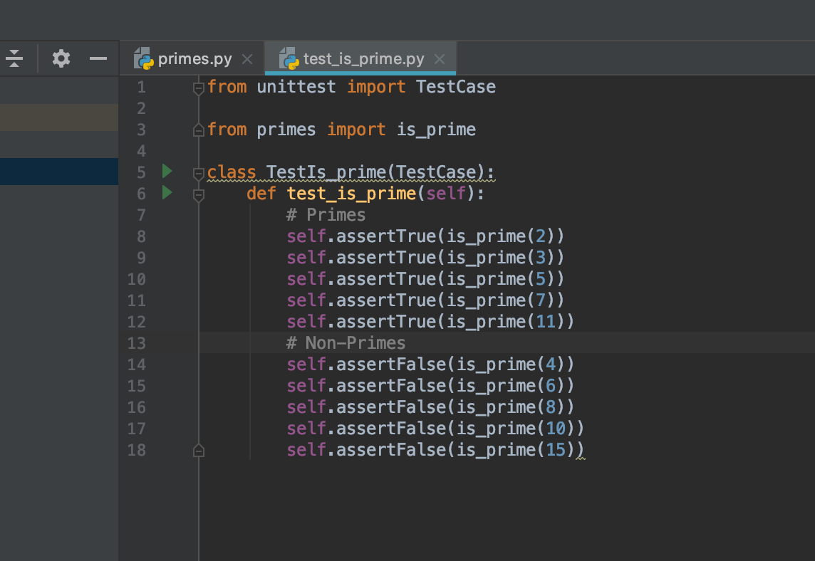
Try adding test

Slide 19
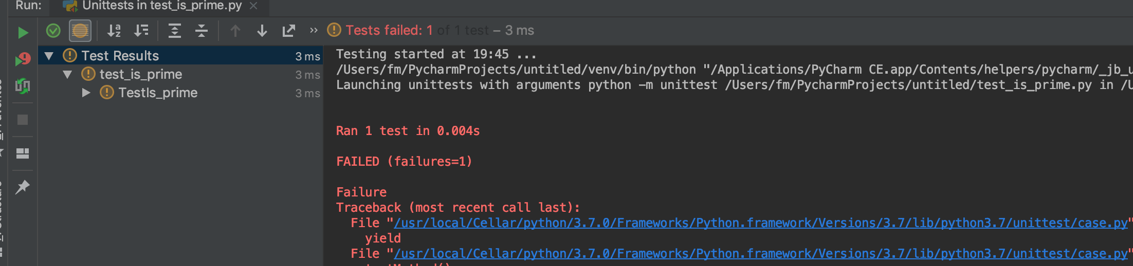
Try adding test

Slide 20
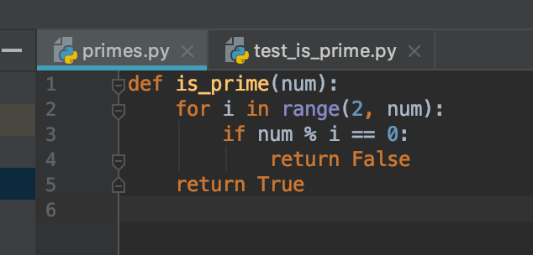
Fix is_prime

Slide 21
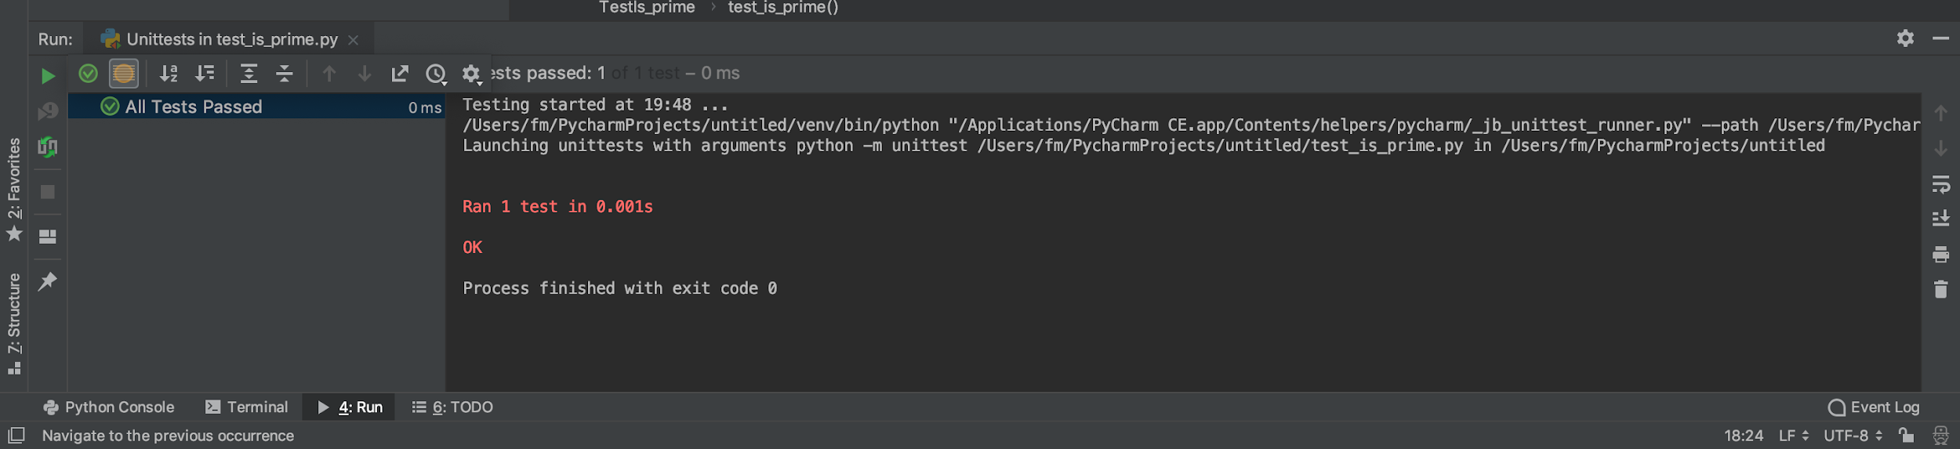
Fix is_prime
All tests passed

Slide 22
Fix is_prime
Are the tests coverage ?

Slide 23
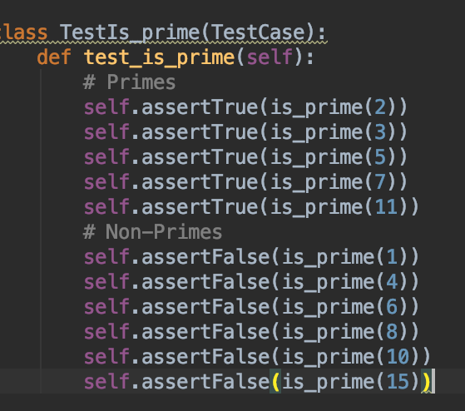
Add 1

Slide 24
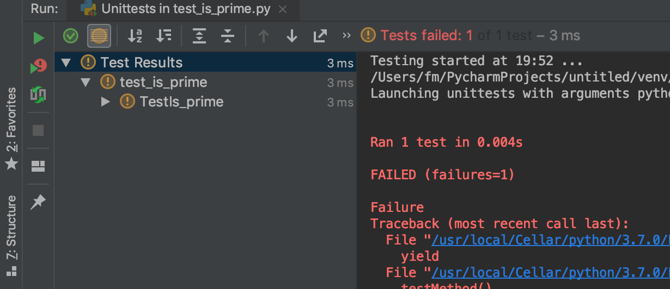
Failed

Slide 25
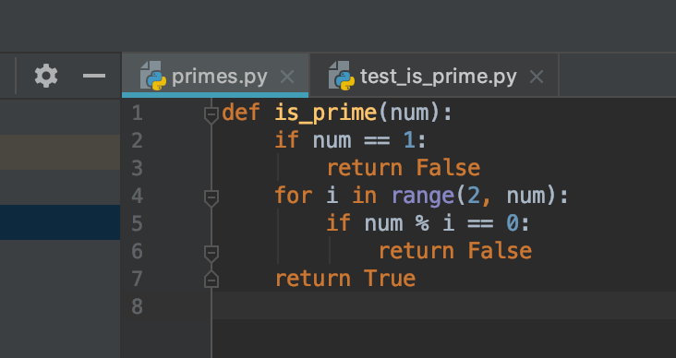
Finally

Slide 26
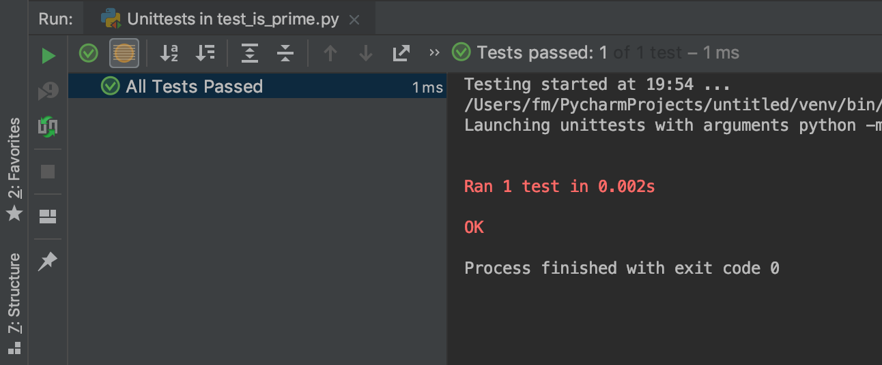
Finally

Slide 27
Automate testing with CircleCI
Fork: https://github.com/CircleCI-Public/circleci-demo-python-django
Clone to your laptop (From your repository)
Go: https://circleci.com

Slide 28
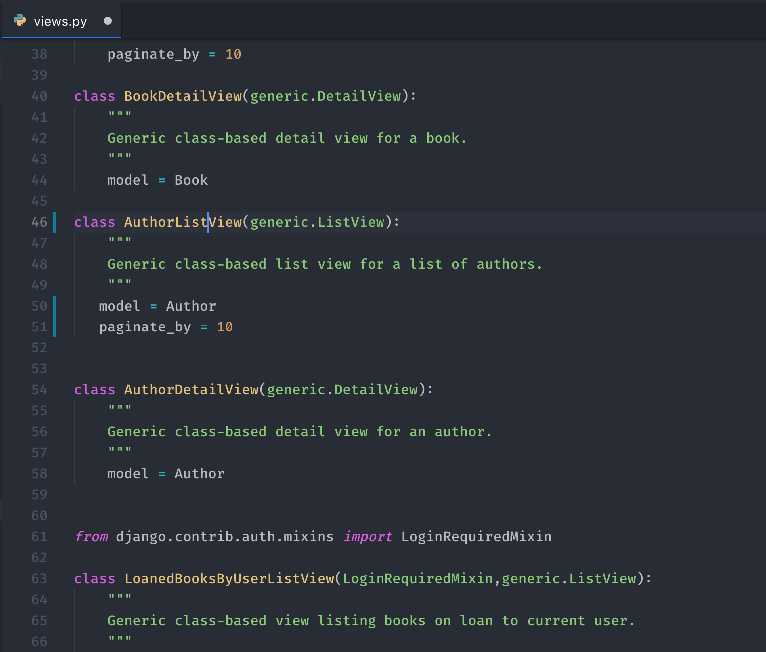
Survey… (catalog/views.py)

Slide 29
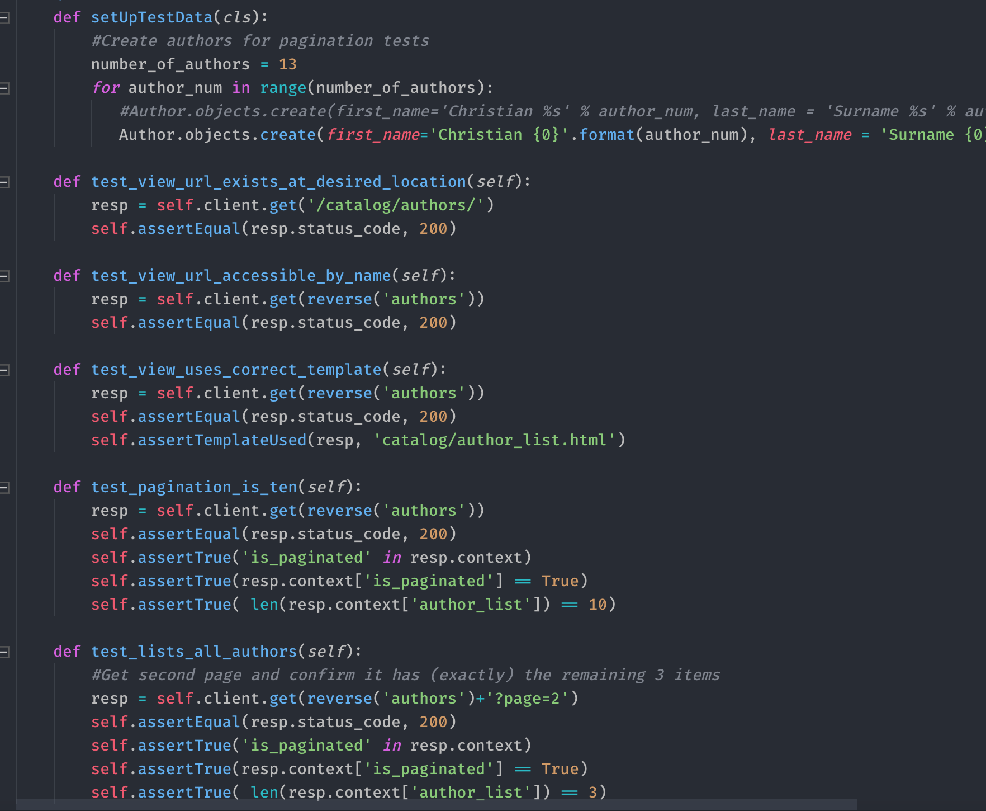
Survey… (catalog/tests/test_views.py)

Slide 30
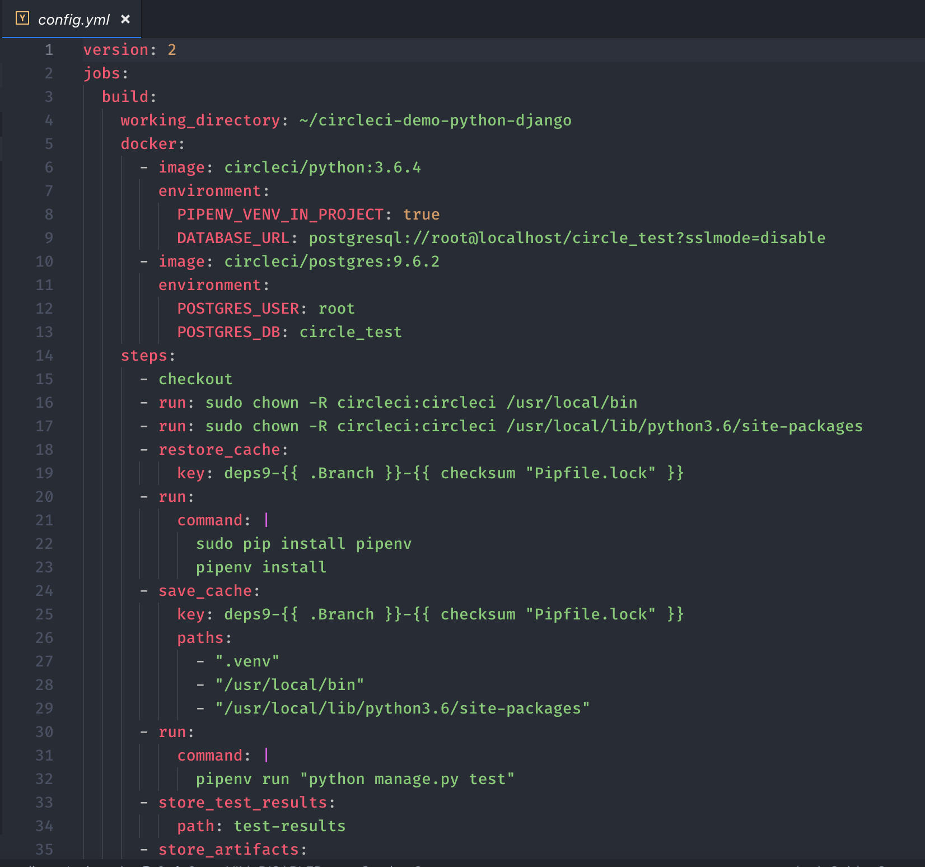
Survey… (catalog/tests/test_views.py)

Slide 31
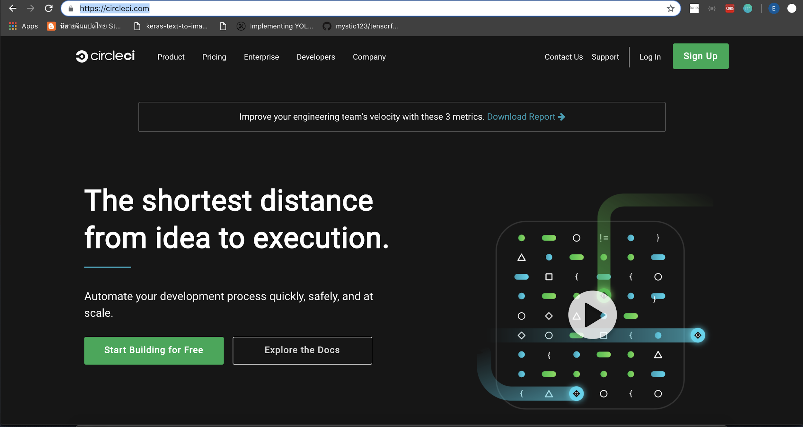
Sign Up

Slide 32
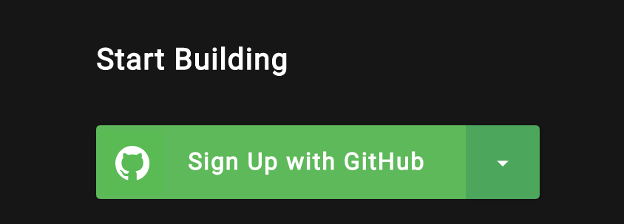
Sign Up

Slide 33
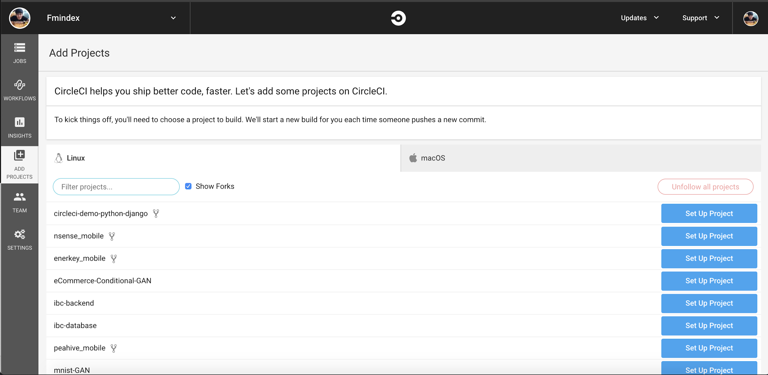
Choose Repo

Slide 34
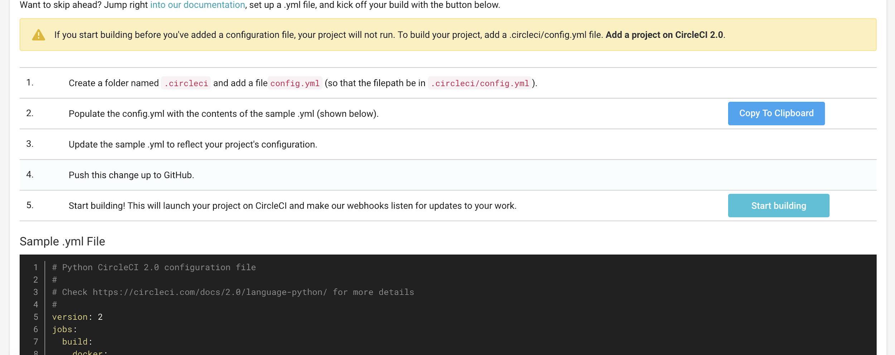
Choose Repo

Slide 35
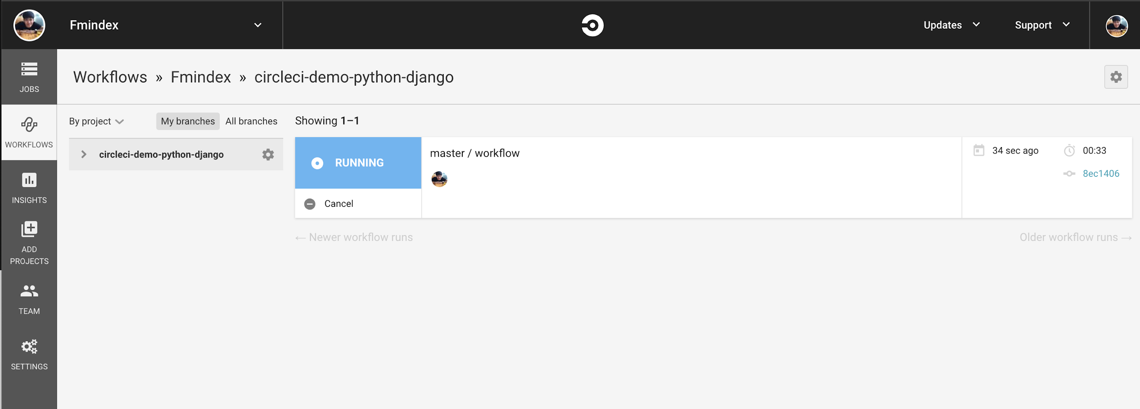
Go to workflow

Slide 36
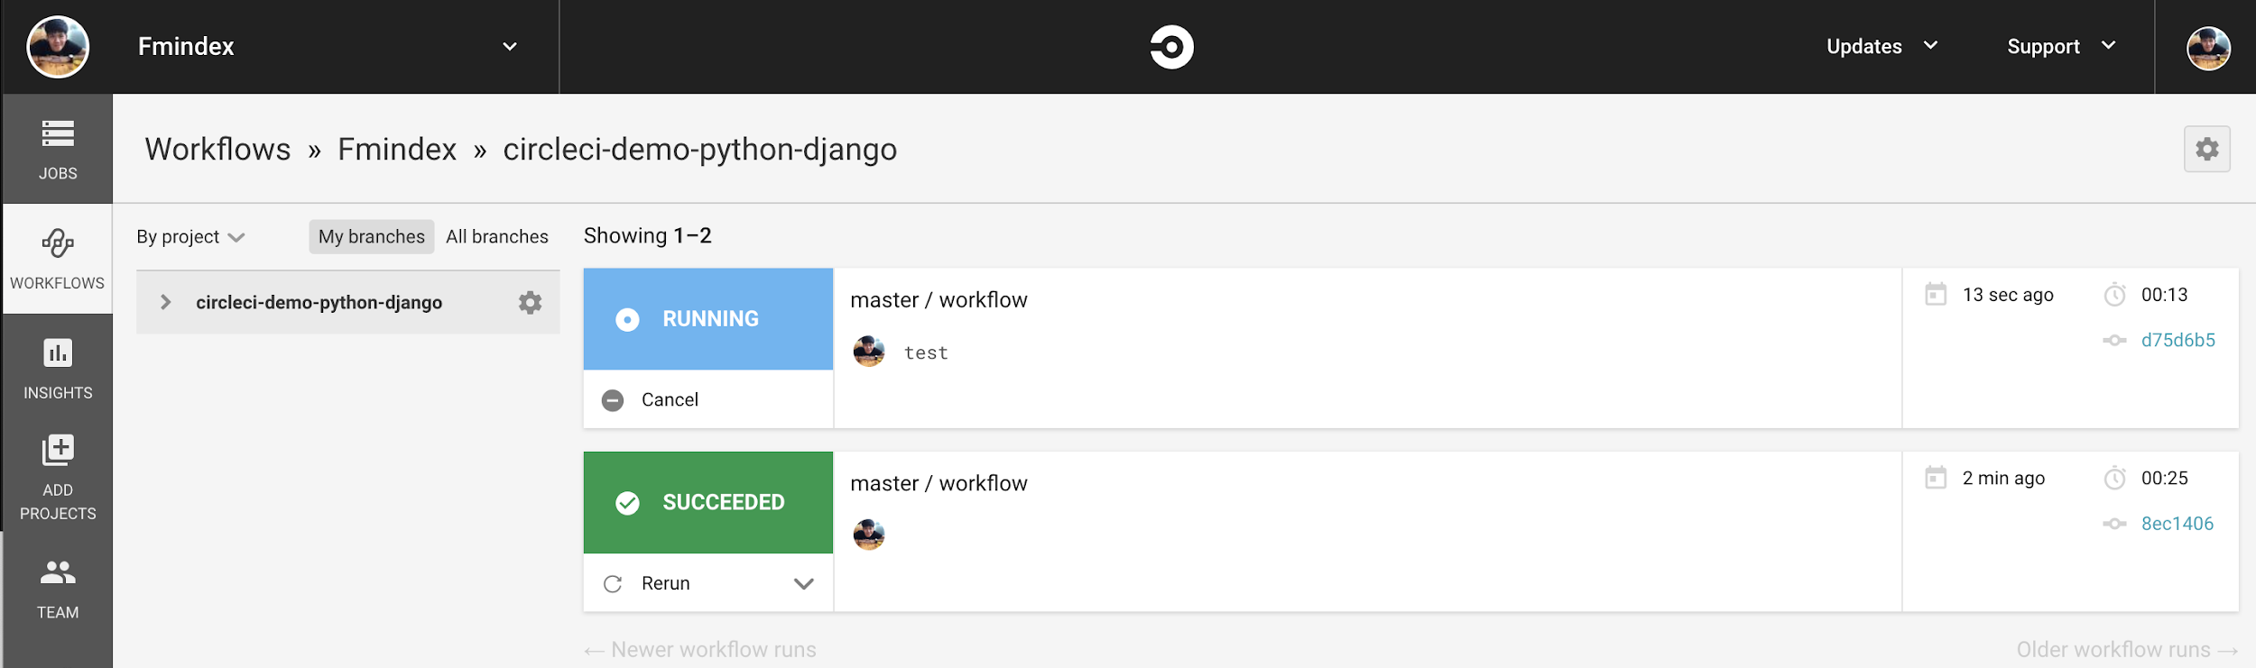
Make some changes
Try editing README.MD
Commit -> Push to origin

Slide 37
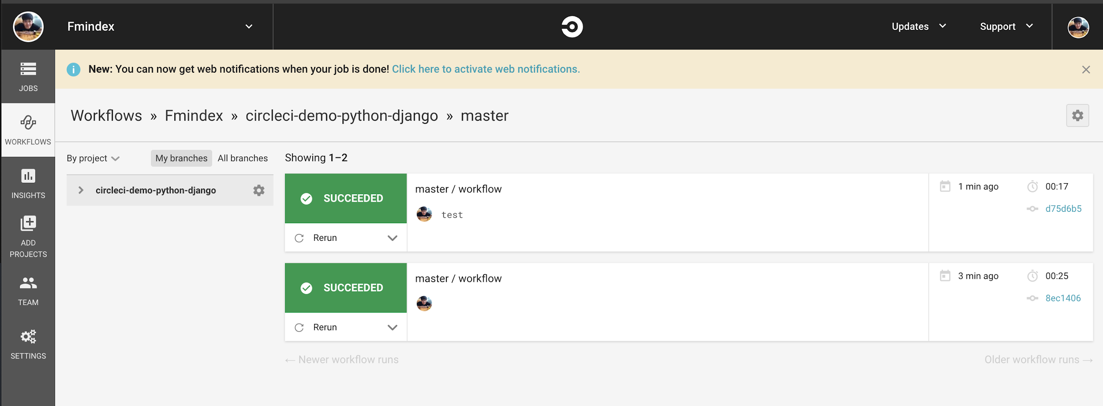
Make some changes
Try editing README.MD
Commit -> Push to origin

Slide 38
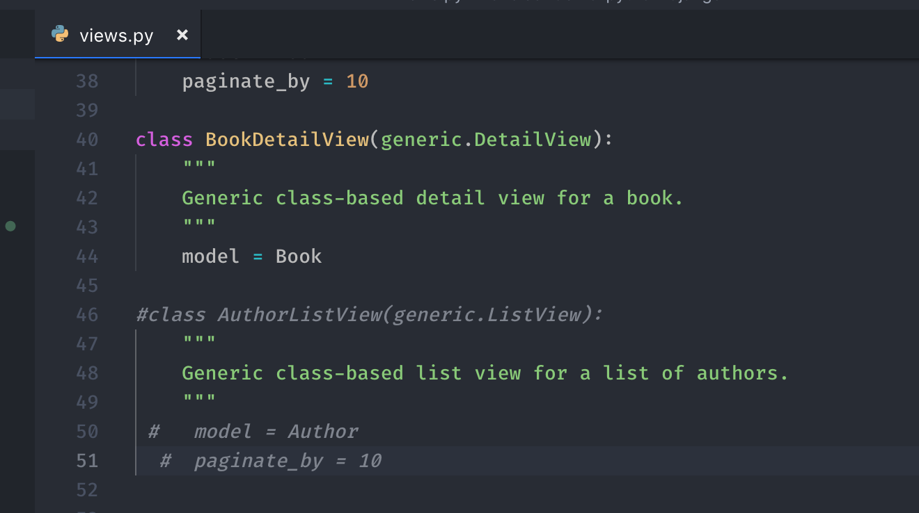
Make some failed
Comment some function….

Slide 39
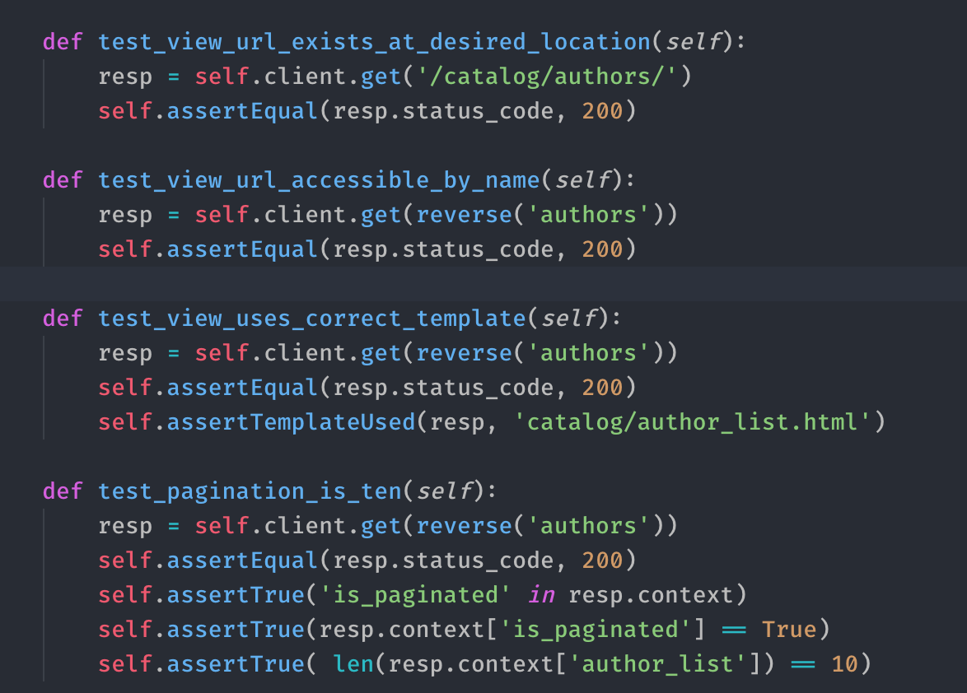
Make some failed
Comment some function….

Slide 40
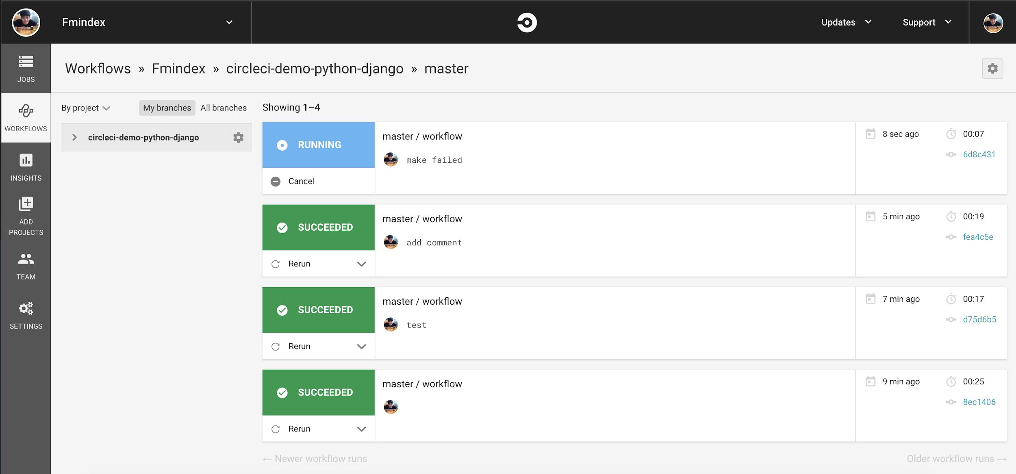
Make some failed
Comment some function….

Slide 41
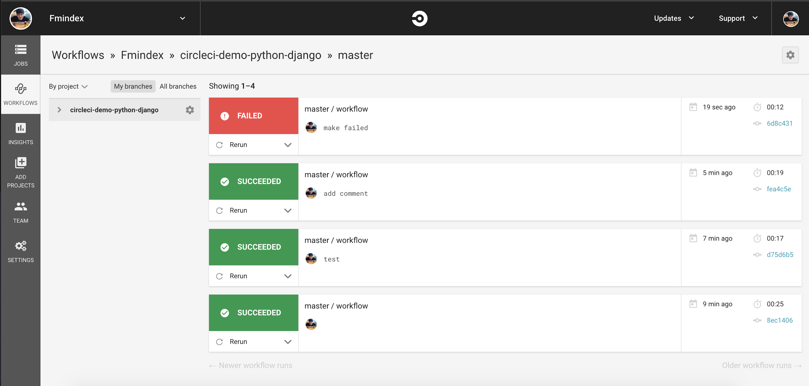
Make some failed
Comment some function….

Slide 42
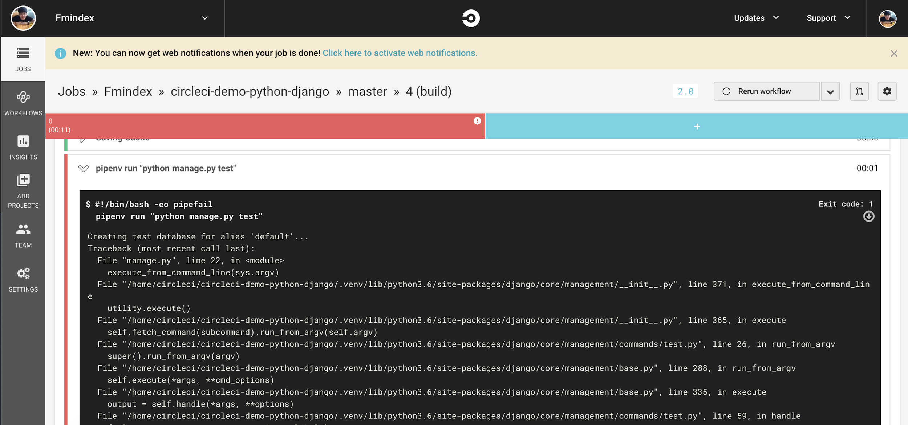
Make some failed
Comment some function….

Slide 43
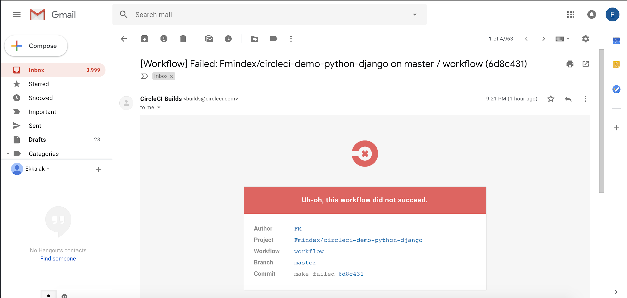
Email notification

